Slide 1


Slide 2
Principles of Typography
“Types of Type”
  Display type
  Body Type
  Serif Typefaces
  Sans Serif Typefaces
  Specialty Type

Slide 3
Principles of Typography
Display Type
  Larger type, 18 points and above
  18, 24, 30, 36, 48, 60, 72
  Used in display pieces (posters, flyers, covers)
  Also used in titles, headlines, and headings
  Dr. Codone is a Great Teacher! = 28 pts bold
  Dr. Codone is a Great Teacher! = 18 pts bold

Slide 4
Principles of Typography
Body Type
  Classic size is 10 point
  Also traditionally 9, 11, and 12 points
  Used for large blocks of text
  Enables reader to read easily

Slide 5
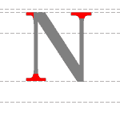
Principles of Typography
Serif
  Derived from ancient Roman letter carvings in stone in which engravers finished each stroke with a serif to correct unevenness in the baseline and cap height
  Serifs are the finishing strokes at the top and bottom of a letter

Slide 6
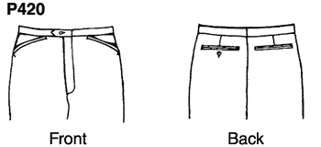
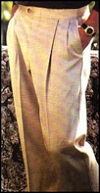
Principles of Typography
Sans Serif
  Sans means “without” serifs
  Plain, unadorned letters
  Arial
  Think “Sans-A-Belt”
  pants

Slide 7
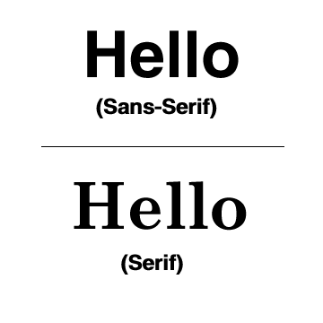

Slide 8
Principles of Typography
Specialty Typefaces
  Script -- imitate calligraphy
  Comic Sans
  Novelty
  Special Sets (Wingdings, etc)
    

Slide 9
Principles of Typography
Type Families
  Those fonts with variations -- all in the same family
    Helvetica
    Helvetica Bold
    Helvetica Narrow
    Arial
    Arial Bold

Slide 10
Principles of Typography
Anatomy of Type
Typography
Serif
Ascender
Point Size
X-height
Cap
Height
Descender

Slide 11
Type Size
Points vs. Picas
  Type size is measured in points
  72 points per inch
  72 points is not quite 1 inch high, but close
  12 points in a pica; 6 picas to an inch, 72 points per inch
  pts (points), pi (pica)
  InDesign uses picas or inches

Slide 12
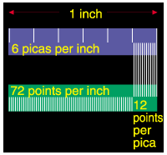
http://www.sallygentieuwelch.com/pixelart/picas.gif

Slide 13
Type Style
Type Style
  Bold
  Roman (normal)
  Italic
  Underline
  Outline
  Shadow
  Emboss

Slide 14
Text Alignment
Text Alignment
  Flush left (ragged right)
  Justified
  Centered
  Flush right (ragged left)

Slide 15
Text Alignment
This is flush left; notice the ragged right edge. Flush left is the most common alignment. This is easier to read and maintains the word spacing and letterspacing intended by the designer of the typeface.

Slide 16
Text Alignment
This is justified text; notice the text is even at the right
and left. White space is evenly distributed between
words and sometimes between characters. Sometimes
words are unevenly spaced and there are “rivers and
lakes” of white space.

Slide 17
Text Alignment
This is flush right; notice the ragged left edge. Flush right should be used only in small blocks and in a contoured shape.

Slide 18
Text Alignment
This is centered text. Extra white space is distributed evenly at the left and right sides of the copy. This should be used only in small blocks, since it is not easy to read. The shape should be contoured; if not, it may just look like improper indentation.

Slide 19
Text Alignment
Text Indentation
  First line
  Hanging indent
    What is a hanging indent? Well, I’m happy to tell you. A hanging indent is where the top line is flush left, but the lines below are indented, just like this .
  Full indent

Slide 20
Principles of Typography
Other Important Items
  Widows -- single, incomplete line at top of a page or column
  Orphans -- same thing at the bottom of page
  Leading -- vertical space b/w lines of type
  Kerning --reduction of horizontal space between characters for a better fit
  Tracking -- uniform reduction of space between all characters in a line

Slide 21
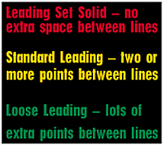
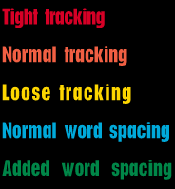

Leading
Tracking
Kerning

Slide 22
Principles of Typography
Always Safe -- use only one typeface, with variations in style and size
Usually Safe -- use sans serif display with serif body type
Take Your Chances -- using both sans serif and serif display and body type
Rarely Effective -- using two very similar or very dissimilar typefaces

Slide 23
Principles of Typography
Selecting Type to Match the Job
  Typeface must be compatible with the message
  Type can be feminine, masculine, friendly, harsh, elegant, delicate, etc
  Start by choosing Times Roman for formal serif applications and Helvetica (Arial) for informal content.

Slide 24
Step-by-Step Design Planning
Rule of Three
  Three colors
  Three typefaces (2 in the same family)
  Three type sizes:
    One size and color for 2/3 of the layout
    One size and color for 2/3 of the remaining 1/3
    Accent color and size for the remaining 1/9

Slide 25

www.dafont.com

Slide 26
Step-by-Step Design Planning
Pre-design planning
  Determine objectives of the design project
  Consider the audience(s)
  Consider elements to be included
  Think about how to project the most appropriate image by your design

Slide 27
Step-by-Step Design Planning
Creating Thumbnails
  Draw thumbnail sketches by hand
  Use post-it notes!
  Or, use Powerpoint or PageMaker to draft thumbnails

Slide 28
Step-by-Step Design Planning
Create your Design using software
  Margins
  Hierarchy -- determine relative importance of each element; focus on top two priority items to help create contrast

Slide 29
Step-by-Step Design Planning
  Proportion -- size of the width to the size of the height
  Uneven proportions are more aesthetically pleasing than even
  8 1/2 x 11 is of uneven proportion
  Keep unequal proportion in mind when positioning page elements; for example, never divide a layout in half by vertically centering a title

Slide 30
Step-by-Step Design Planning
  Golden Mean

Slide 31

Not the Golden Mean!

Slide 32
The Golden Mean!

Slide 33
The Golden Mean!

Slide 34
Step-by-Step Design Planning
  Unity -- ensure no elements appear isolated or look as though they are floating in space; use borders, lines, etc to unify the layout.

Slide 35
Step-by-Step Design Planning
  Use Grids to help design your page
    Grids bring order & consistency
    Grids form a graphic backbone
    Grids establish a logical page layout

Slide 36
Three Column Grid

Slide 37
Two Column Grid

Slide 38


